Slide 1








From rivers to the ocean:
Using habitat models to understand and predict variations in central California salmon
Eric Danner
NOAA Fisheries
NOAA
Steve Lindley
Andrew Pike
Lynn Dewitt
Mark Henderson
Brian Wells
NASA Ames
Rama Nemani
Forrest Melton
Remote Sensing Solutions
Yi Chao
MBARI
Francisco Chavez
Monique Messié
University of Maine
Fei Chai
Shivanesh Rao
University of California Santa Barbara
Roger Nizbet
Ben Martin
Laure Pecquerie
California Department of Water Resources
Eli Ateljevich
Kijin Nam
Romberg Tiburon Center for Environmental Studies
Dick Dugdale

Slide 2
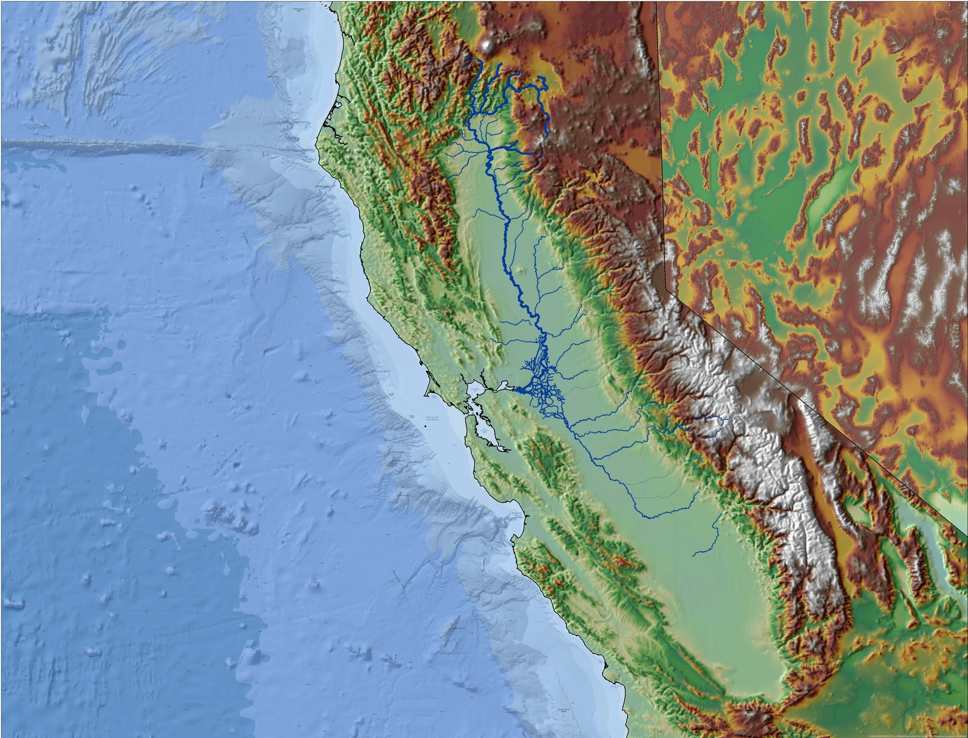
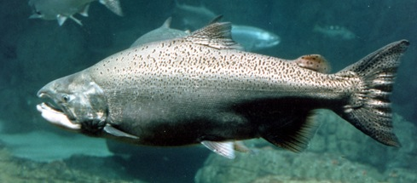
Credit: NOAA NMFS

Slide 3
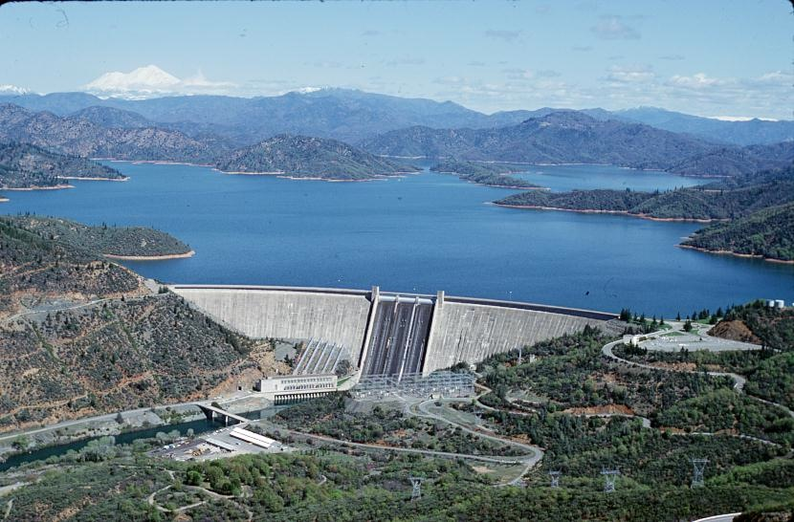
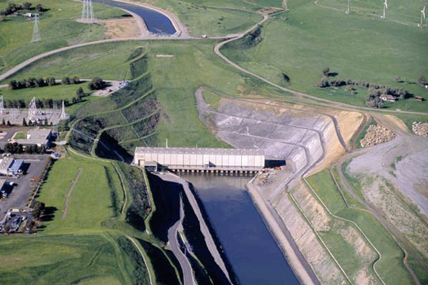

Slide 4
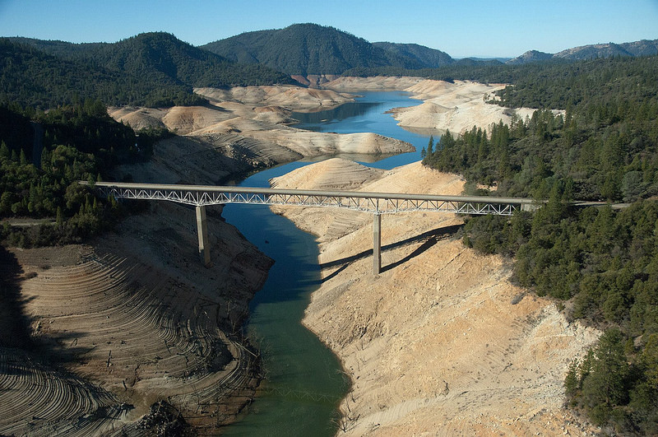
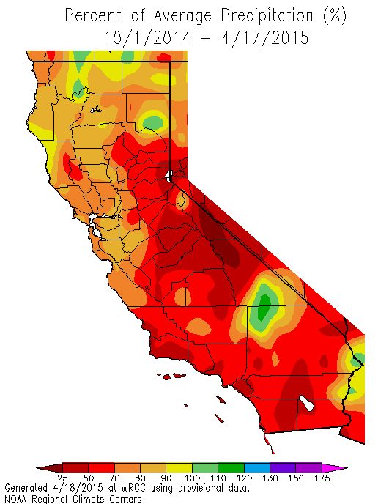
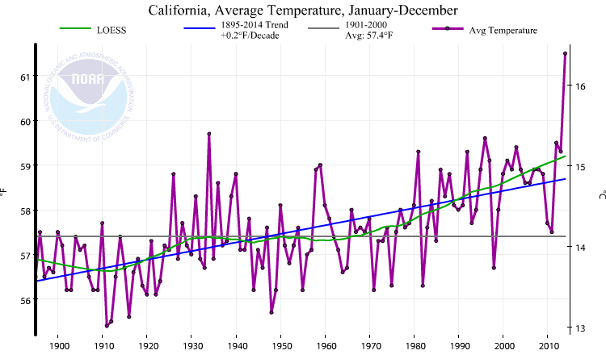
First-ever statewide water restrictions…25%

Slide 5

"I want $30 billion...to build a pipeline like the Alaska pipeline, from Seattle - a place where there's a lot of water. There's too much water…
…keep it above ground - because if it leaks, you're irrigating!”
-William Shatner

Slide 6
Dams?
Diversions?
Fishing?
Ocean Conditions?

Slide 7
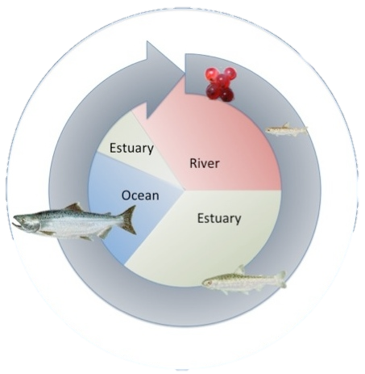
How to assess the quantity and quality of habitat with respect to water management?
Water velocity
Water temperature
Food density
2. How to model these values over this large and complex landscape?

Slide 8
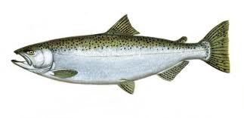
Dynamic Energy Budget (DEB) Models
Input
Food
Temperature
Velocity
Output
Growth
Fecundity
Migration costs
Embryonic dev.
Age at maturity
Maintenance
Maintenance
Growth
Maturation
Reproduction

Slide 9
RAFT
AQUATOX
Sacramento River
SCHISM
CoSiNE
San Francisco Estuary
ROMS
CoSiNE
Coastal Ocean

Slide 10
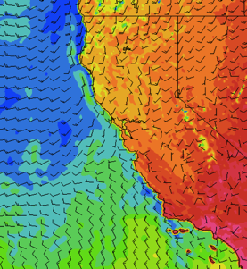
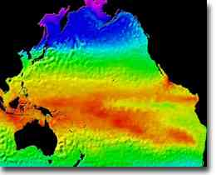
Coupled Physical-Biological Models
RAFT
AQUATOX
Sacramento River
Food
Temperature
Velocity
COAMPS
SCHISM
CoSiNE
Salmon DEB Model
Eggs / Juveniles / Adults
San Francisco Estuary
Food
Temperature
Velocity
ROMS
CoSiNE
ROMS
Growth
Fecundity
Migration costs
Embryonic dev.
Age at maturity
Coastal Ocean

Slide 11
Dam release temperatures

Slide 12
Dam release temperatures

Slide 13
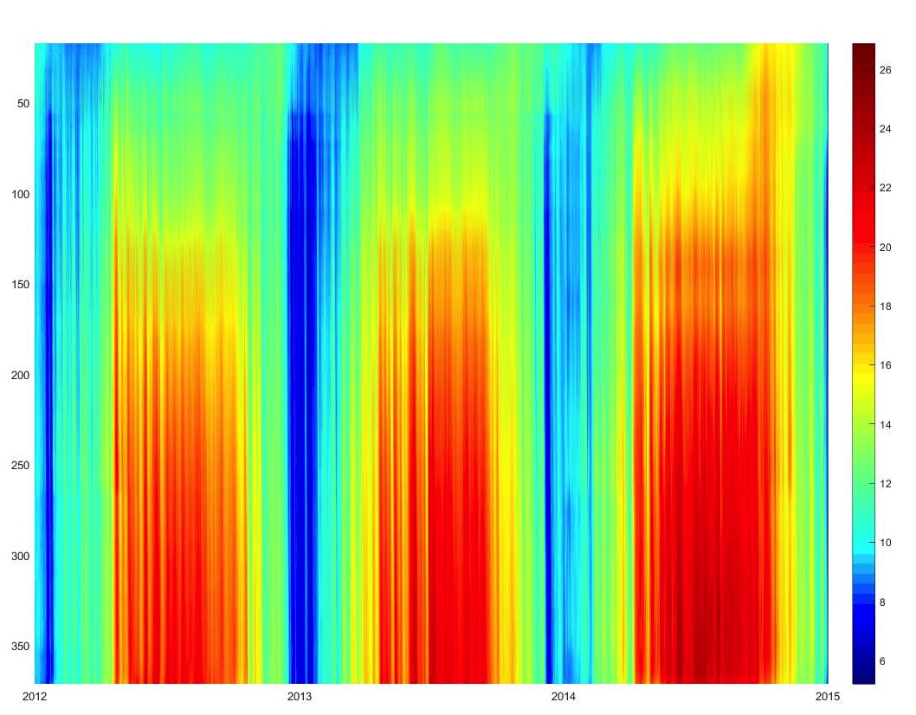
Sacramento River Temperatures
Distance from dam
Temperature
2012 2013 2014 2015

Slide 14
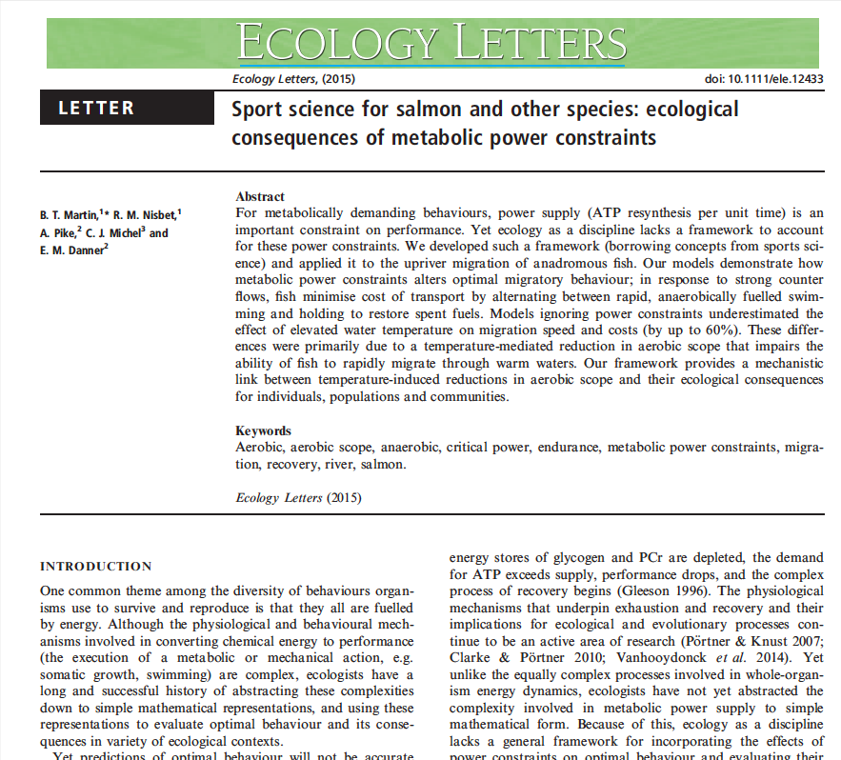
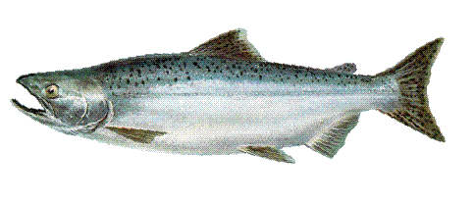
What are the costs for an adult fish migrating upstream?

Slide 15
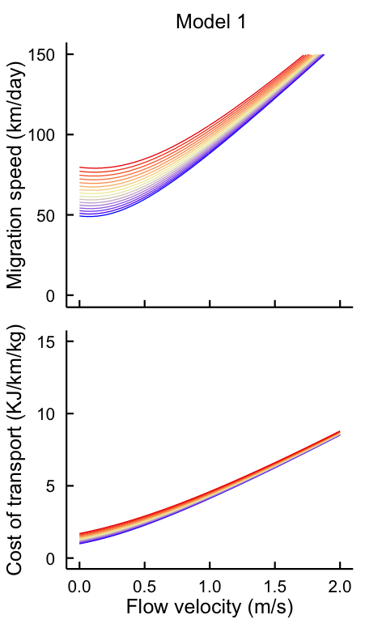
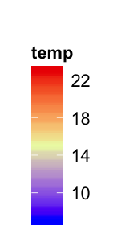
DEB Model: Adult Migration
Adult salmon migrating upstream face limits on power supply
Martin et al., Ecology Letters

Slide 16
DEB Model: Adult Migration
Adult salmon migrating upstream face limits on power supply
Martin et al., Ecology Letters

Slide 17
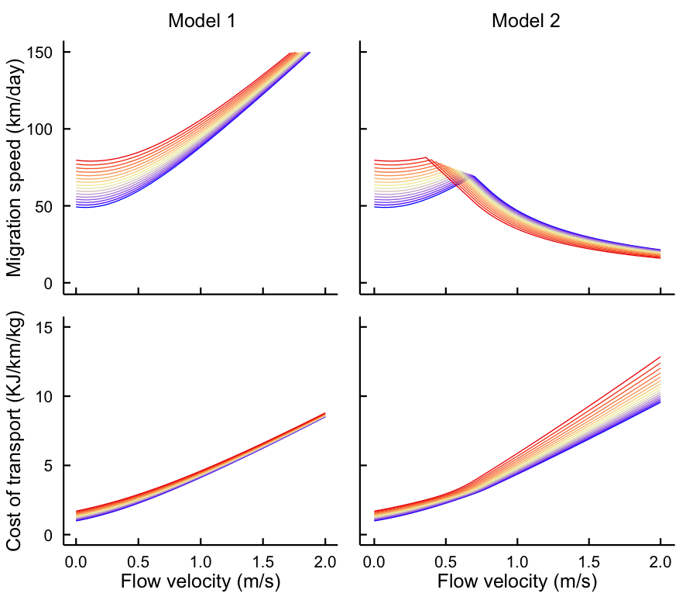
DEB Model: Adult Migration
Adult salmon migrating upstream face limits on power supply
Martin et al., Ecology Letters

Slide 18
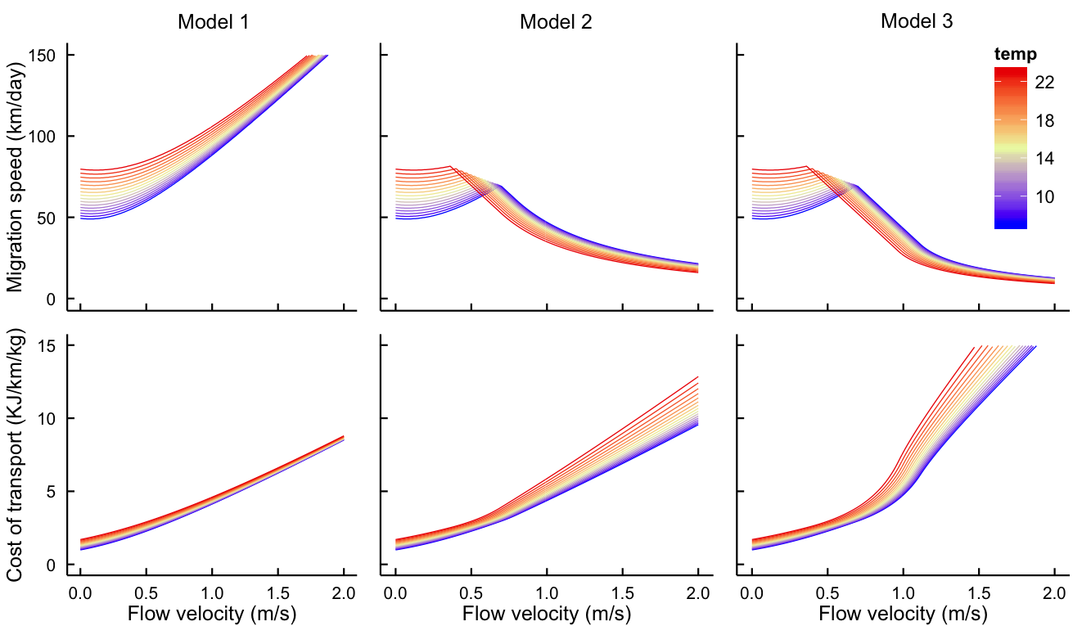
DEB Model: Adult Migration
Adult salmon migrating upstream face limits on power supply
Martin et al., Ecology Letters

Slide 19
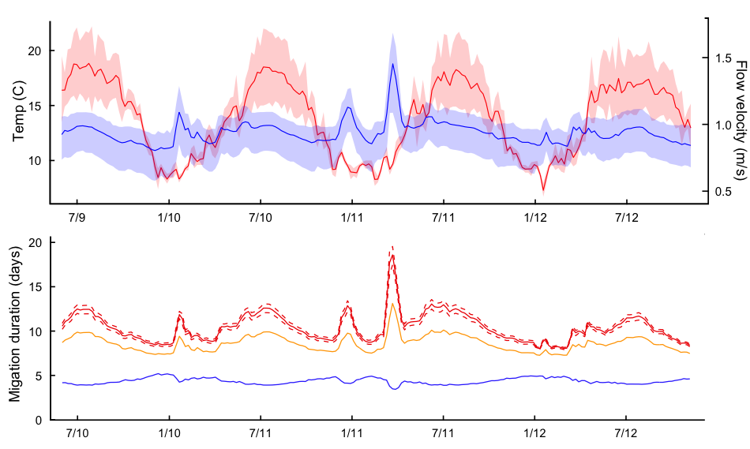
DEB Model: Adult Migration
Martin et al., Ecology Letters

Slide 20
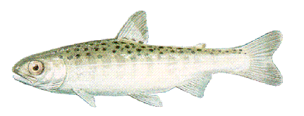
How do environmental conditions effect juveniles entering the ocean?

Slide 21
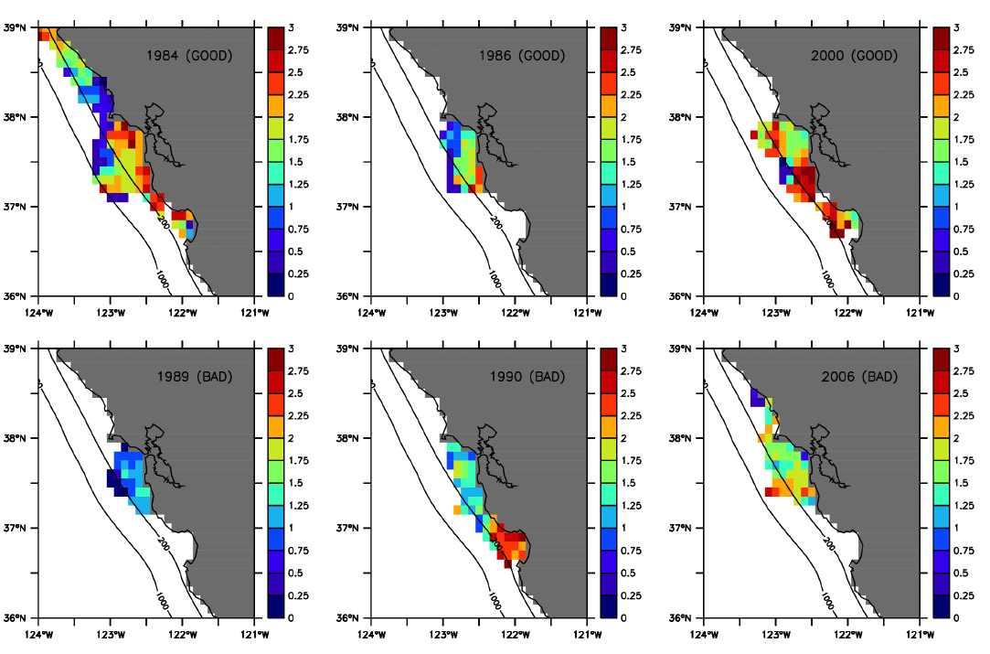
DEB Model: Early Ocean Entry
Simulated maximum monthly averaged growth rate (g day-1)
Good Years
Bad Years
Fiechter et al., in press

Slide 22
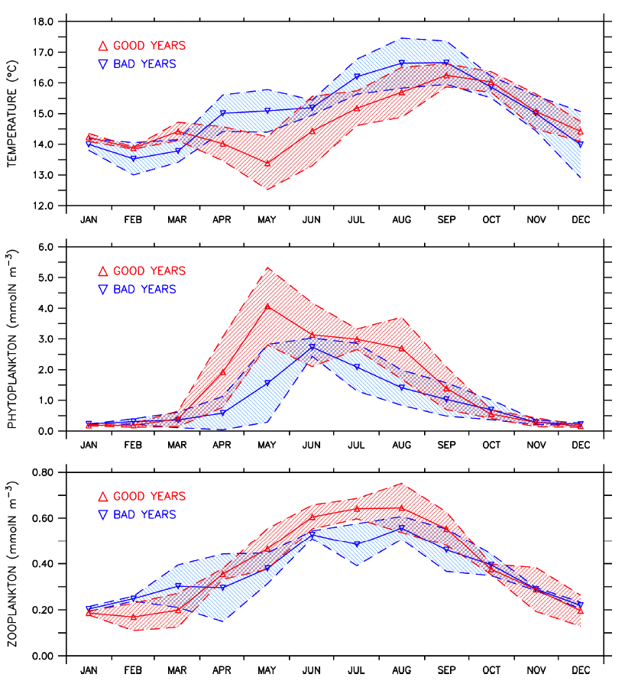
DEB Model: Early Ocean Entry
Fiechter et al., in press

Slide 23
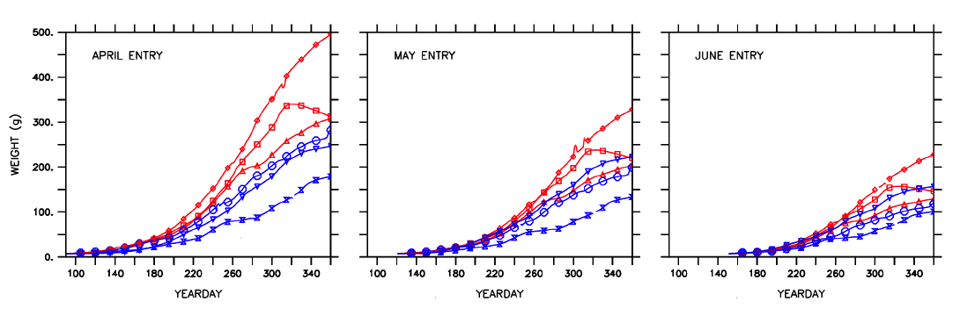
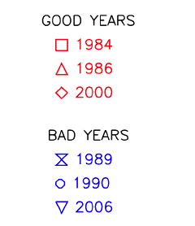
DEB Model: Early Ocean Entry
Fiechter et al., in press

Slide 24
DEB Model: Juvenile Salmon
Distribution of energy densities in Chinook smolts
Data from MacFarlane 2010

Slide 25
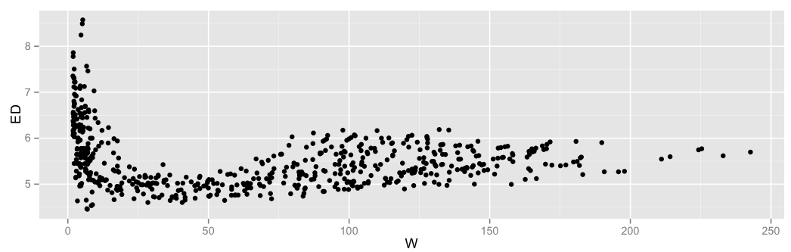
DEB Model: Juvenile Salmon
Data from Macfarlane 2010
Energy density (KJ/g)
Weight (g)
DEB model predictions
Energy density (KJ/g)
Weight (g)

Slide 26
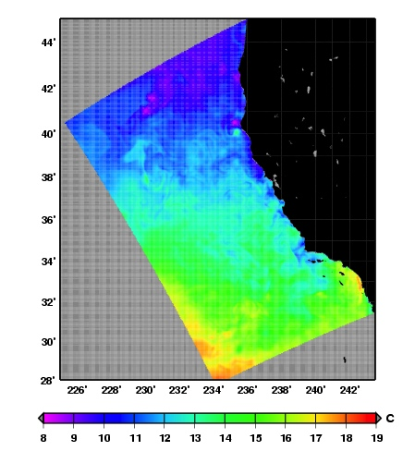
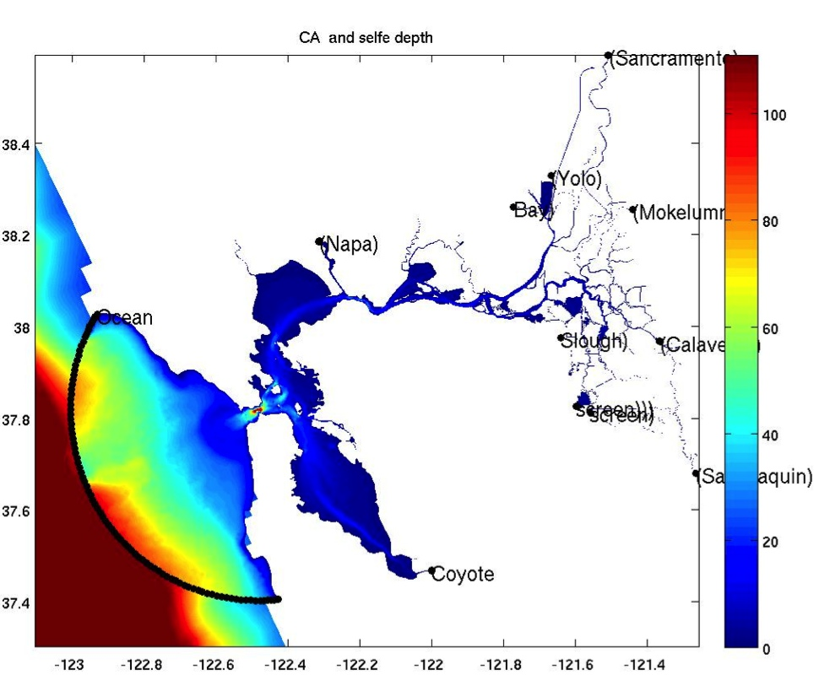
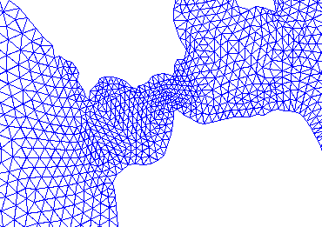
Physical Model: Estuary Habitat
Linking California coastal ocean model with
San Francisco Bay/Estuary model
Golden
Gate
ROMS
3-km
Unstructured grid SELFE
1-km………………..10-m

Slide 27
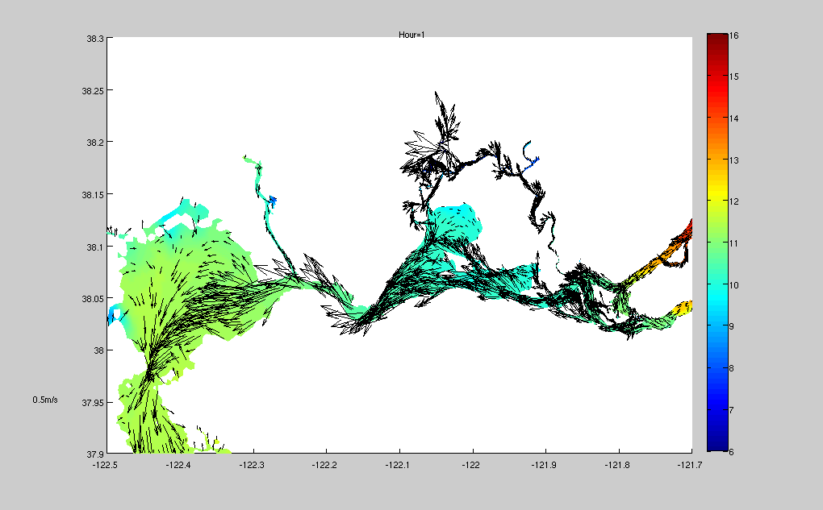
Physical Model: Estuary Habitat
Temperature

Slide 28
Biological Model: Estuary Habitat
Distance from Sac River (km)
Distance from Sac River (km)
Month
Month

Slide 29
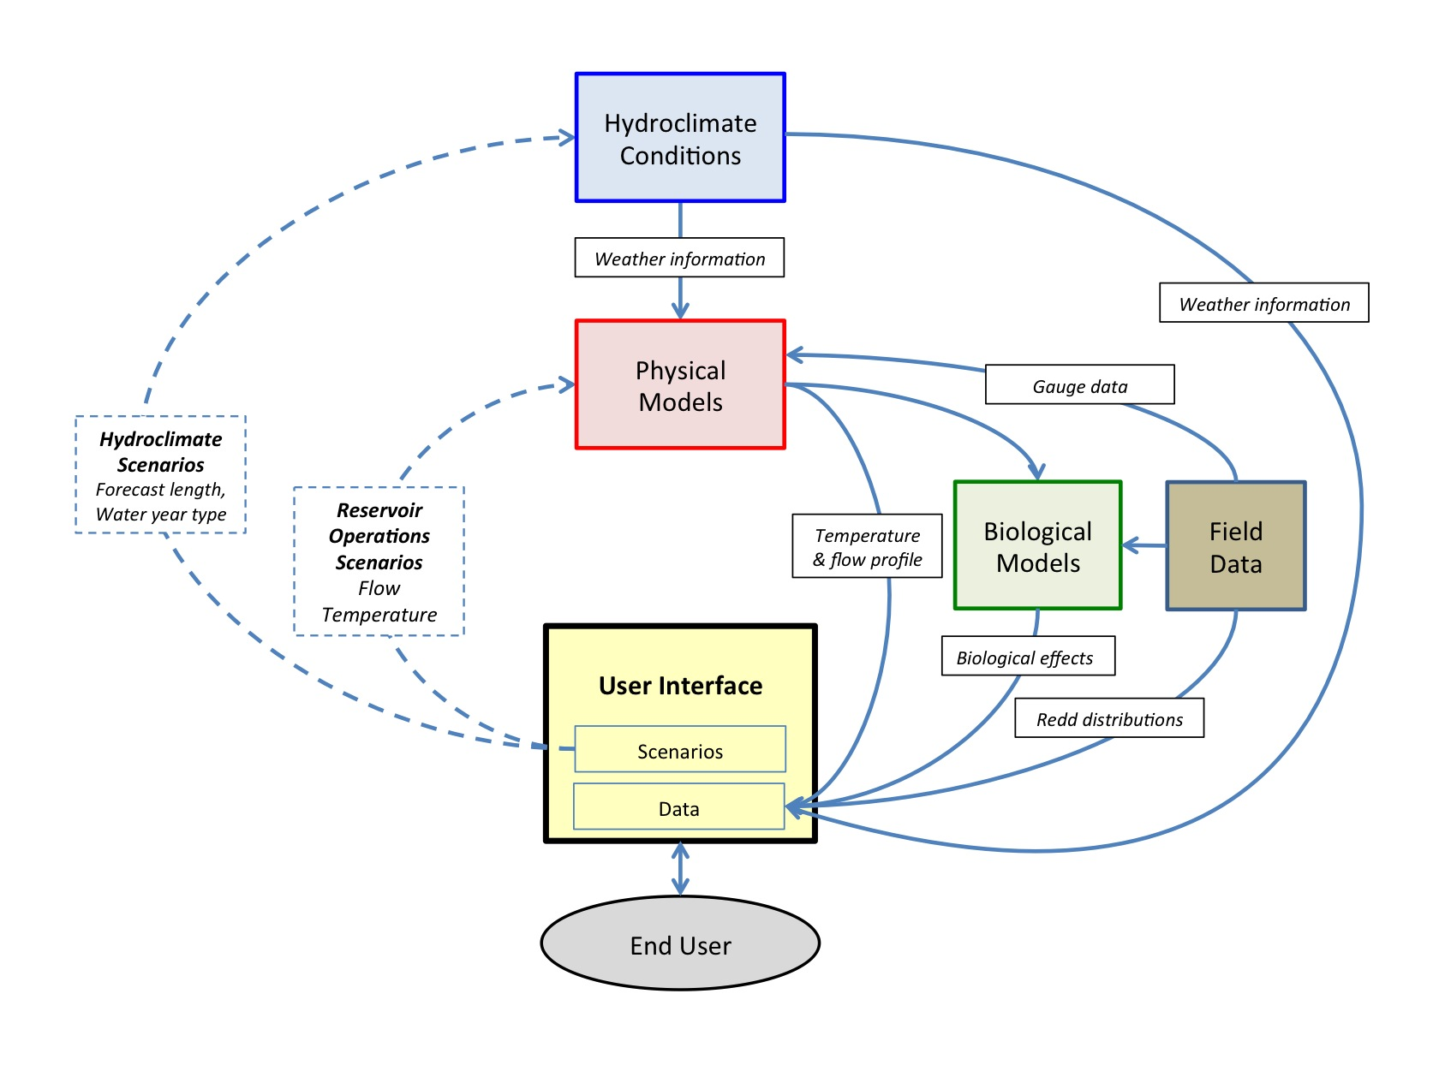
Decision Support Tool

Slide 30
Summary
California is faced with critical water shortages and difficult decisions on water allocation
Developing decisions support tools for water and fisheries management
Ongoing agency funding to continue
All started with NASA funding

Slide 31

Thank you
This work is supported by grants from
NASA Applied Sciences
and
NOAA Fisheries

